Slide 1
Coronavirus
Project
Team Quandary Peak
Candice Chuang, Qingdi Xiao, Wen Huang, Wenbin Yang, Yuxiang Wang

Slide 2
Agenda
Part I: Introduction
Part II: Text Mining
Topic Model
Word Cloud
Part III: Visualization
Part IV: Predictive Analysis
Part V: Conclusion and Suggestion
Notes:
We have 4 parts in our presentation,
Introduction,
text mining,
visualization,-> to compare situations of wol
predictive analysis
Time series
Randimforest

Slide 3

01
INTRODUCTION
Notes:
COVID-19 is a Global Pandemic and coronavirus is a Fast-moving virus.
To better understand COVID 19 spreading past and future in the United States,
the project compared the outbreak among serious regions and the overall United States situation.
We integrate both the statistical predicting models,visua,and texting mining technique.

Slide 4
Data description
Tableau COVID-19 Data Hub
COVID-19 Cases_new.csv (https://www.tableau.com/about/blog/2020/3/coronavirus-data-hub-faq)
COVID-19 in USA
us_states_covid19_daily.csv
(https://www.kaggle.com/sudalairajkumar/covid19-in-usa#us_covid19_daily.csv)
COVID-19 Open Research Dataset Challenge (CORD-19)
news.csv
( https://www.kaggle.com/allen-institute-for-ai/CORD-19-research-challenge)
Notes:
Our data is from Tableau and Kaggle. The first two collected data from January 23 to April 10, the last one is from January 8 to March 27
The data comes from the dataset maintained and updated by the Johns Hopkins University Center for Systems Science and Engineering. Tableau cleans, reshapes, This dataset updated by 9:00am EST every day. 4 10
This dataset has details information from 50 US states and the District of Columbia at daily level. This dataset contains date, total case of states, number of positive and negative cases, pending cases, number of recovered and death, and number of death increasing by daily.
CORD-19 is a resource of over 51,000 scholarly articles, including over 40,000 with full text, about COVID-19, SARS-CoV-2, and related coronaviruses
We separated the COVID 19 research to three aspects, including (翻页）

Slide 5

Process
Amazon S3
Bucket
Local
EMR Cluster
Leeds EMR jupyter notebook Cluster
Notes:
We upload data from local to EMR Cluster, and then transform data to S3, finally link with Leeds Cluster
Upload data from local to EMR cluster
scp -i Leed_HadoopKeypair.pem /Users/xiximywife/Documents/GitHub/Team-Torreys-Peak/data/news.csv hadoop@ec2-52-13-183-139.us-west-2.compute.amazonaws.com:~/Team-Quandary-Peak/
Transform data from EMR to S3
Link S3 Bucket and Leeds EMR jupyter notebook Cluster

Slide 6





Tools
Coding
Storing datasets (EMR,S3Bucket)
Using Pyspark for data cleaning and Word Cloud
Creating Jupyter Notebooks on EMR
Platform for Displaying
Using Github for merging all parts and displaying
Coding Review
Using Binder for reviewing codes

Slide 7
02
TEXT MINING

Slide 8
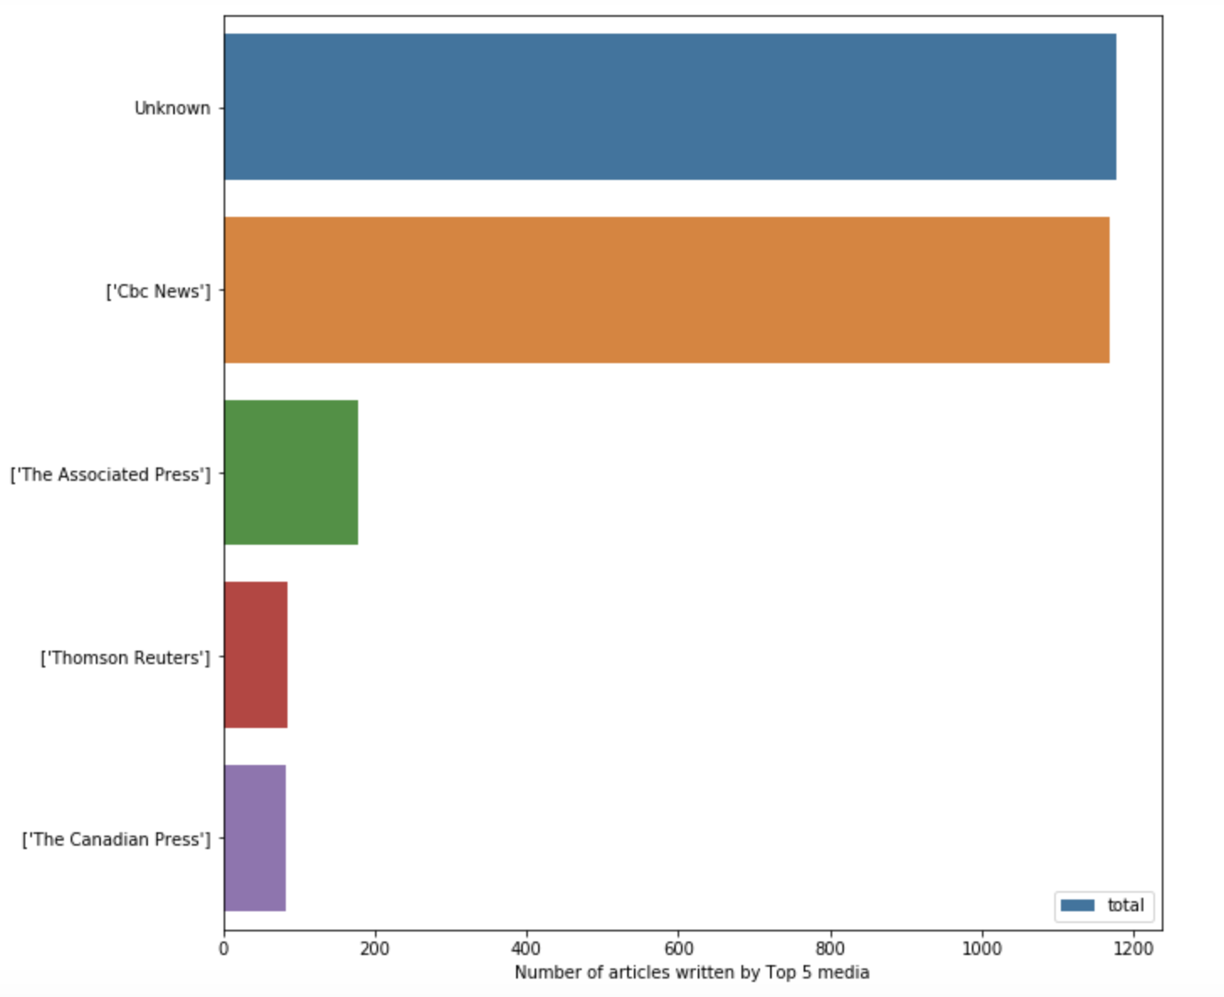
news.csv
Basic Info
Number of Articles Written by Top 5 media

Slide 9
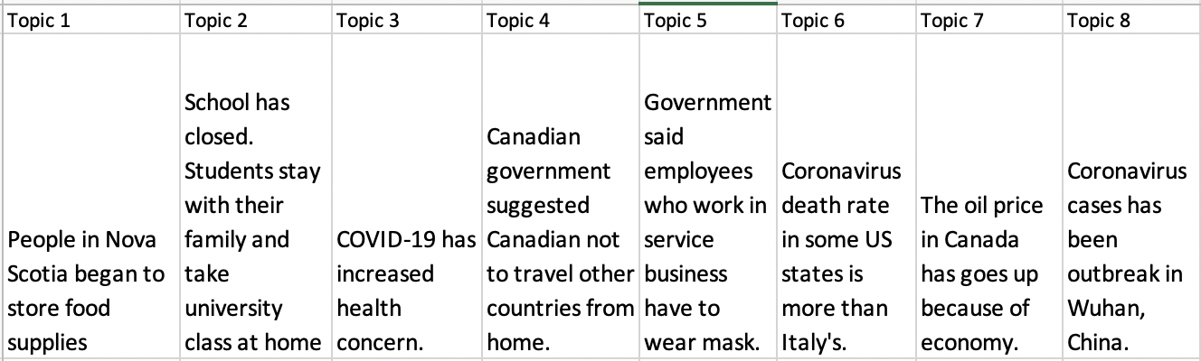
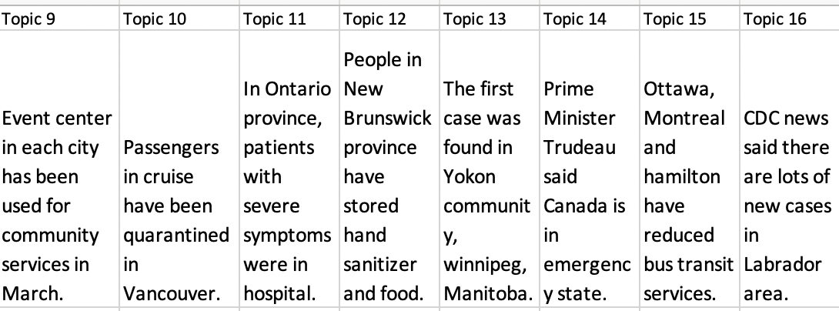
news.csv
Topic Model
Dividing the whole text into 16 topics
Notes:
People in Nova Scotia began to store food supplies.

Slide 10
news.csv
Before Word Cloud...
Data Cleaning
Group news by date
Remove Punctuations, some unwanted words by Spark
Get the Top 10 frequent words by Spark on
all news
daily news

Slide 11

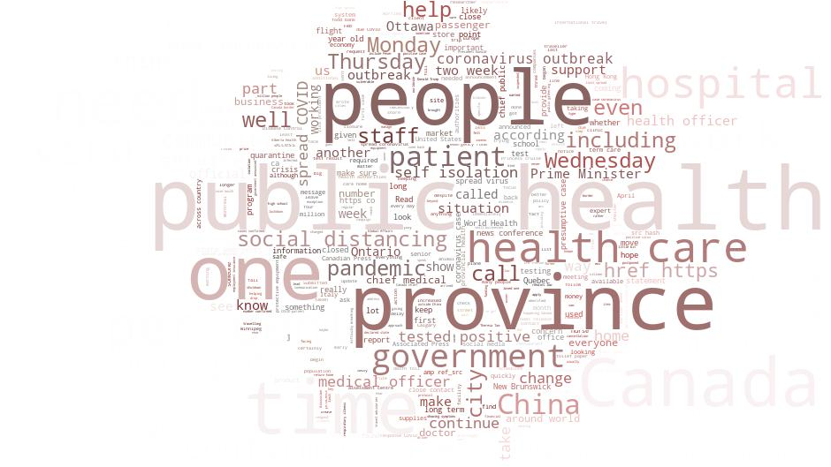
news.csv
Word Count
from 1/8 to 3/27

Slide 12
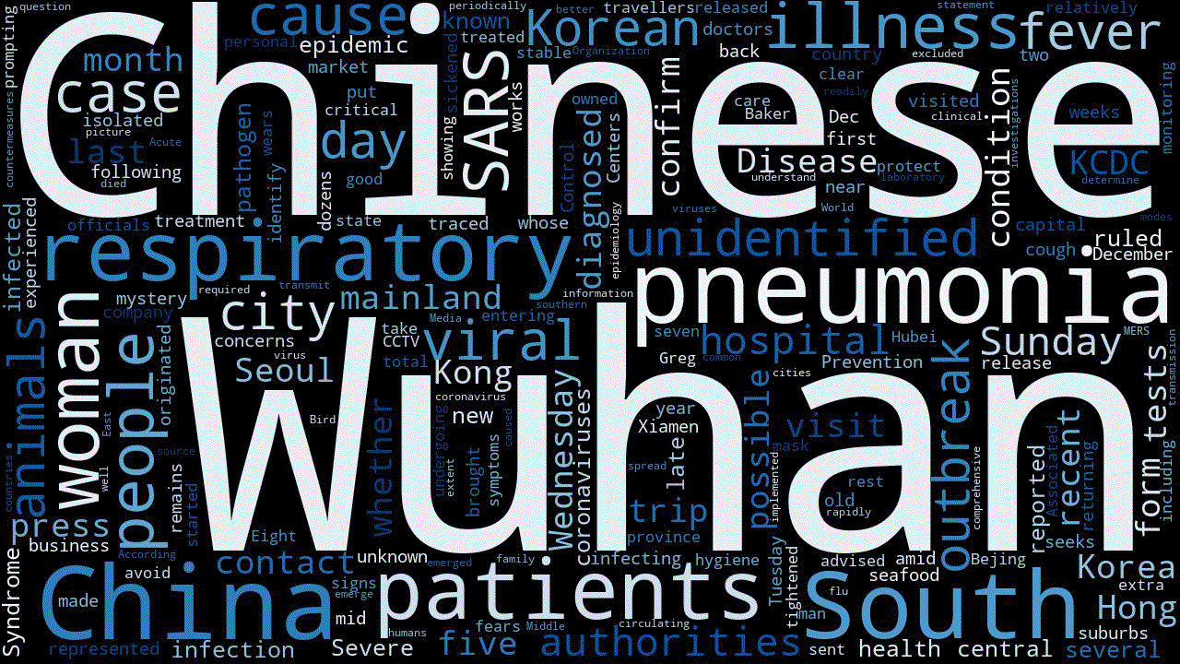
news.csv
Daily News
First 10 days
(January)

Slide 13
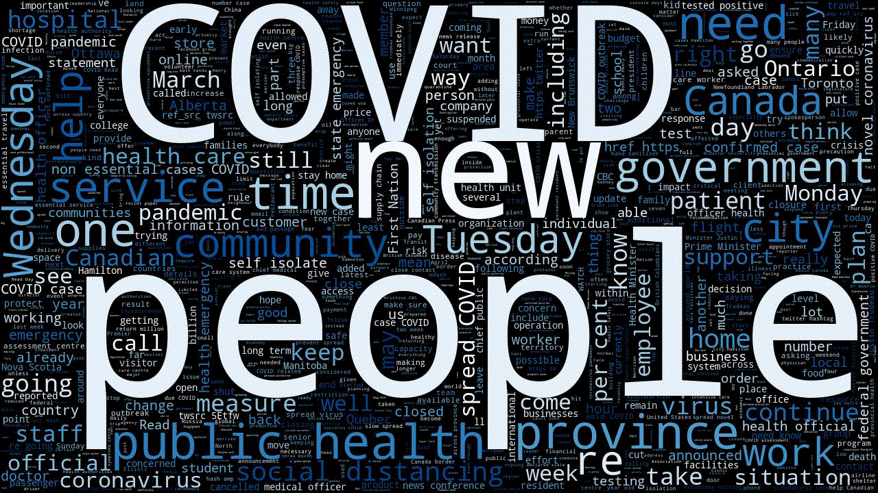
news.csv
Daily
News
Last 10 days
(March)

Slide 14
03
VISUALIZATION

Slide 15
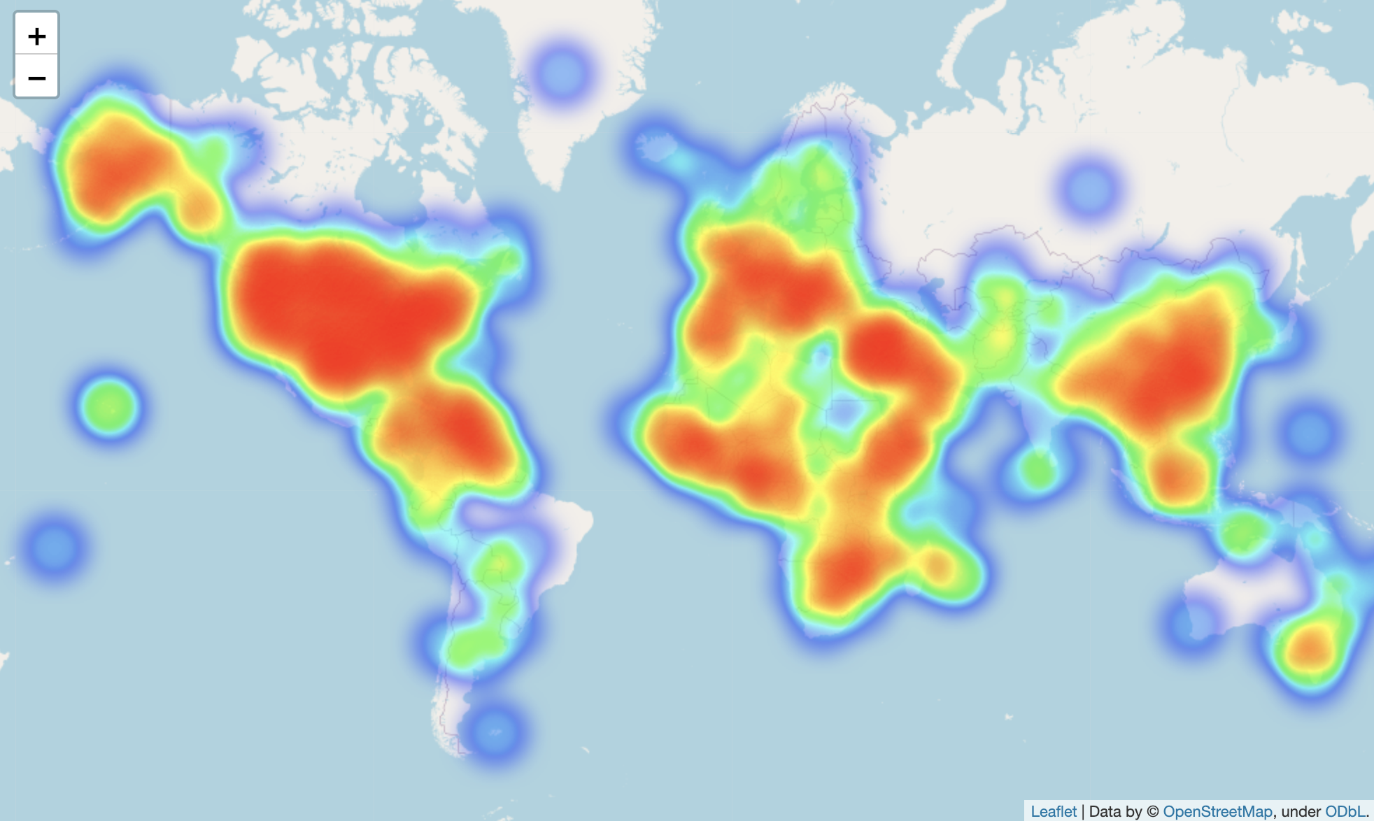
World map at April 10

Slide 16
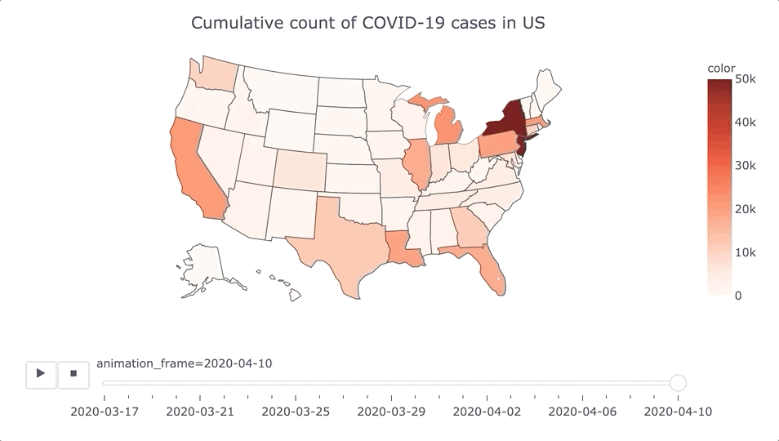
Description n Visualization

Slide 17
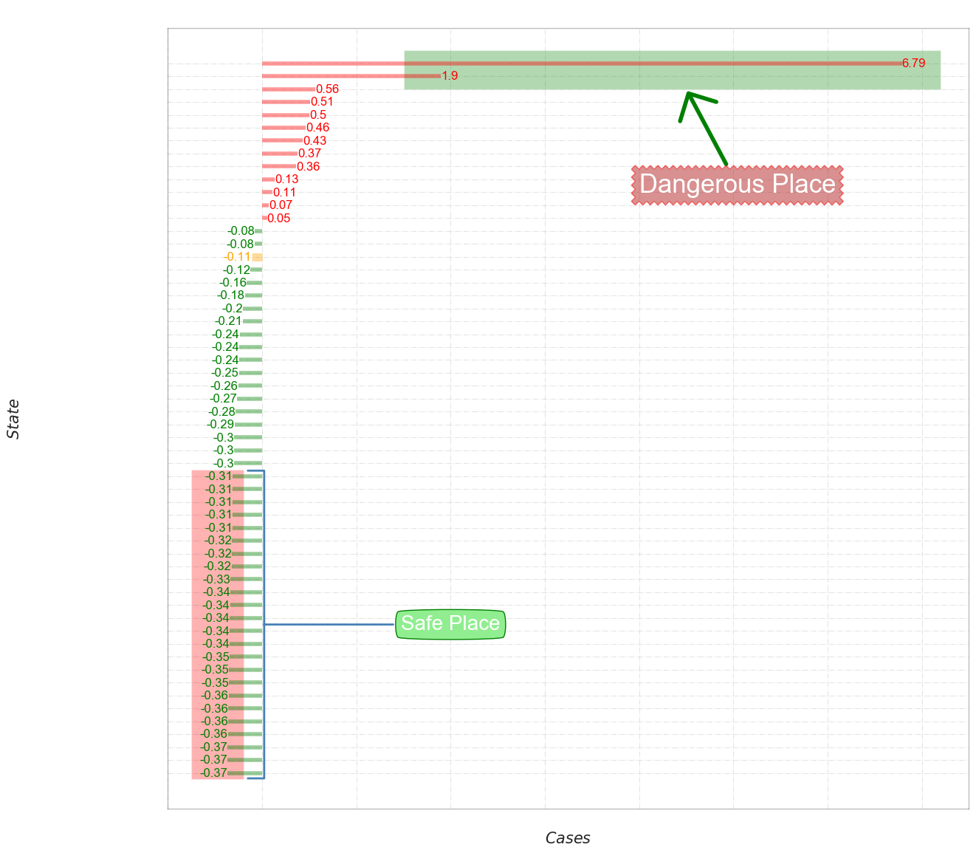

Slide 18
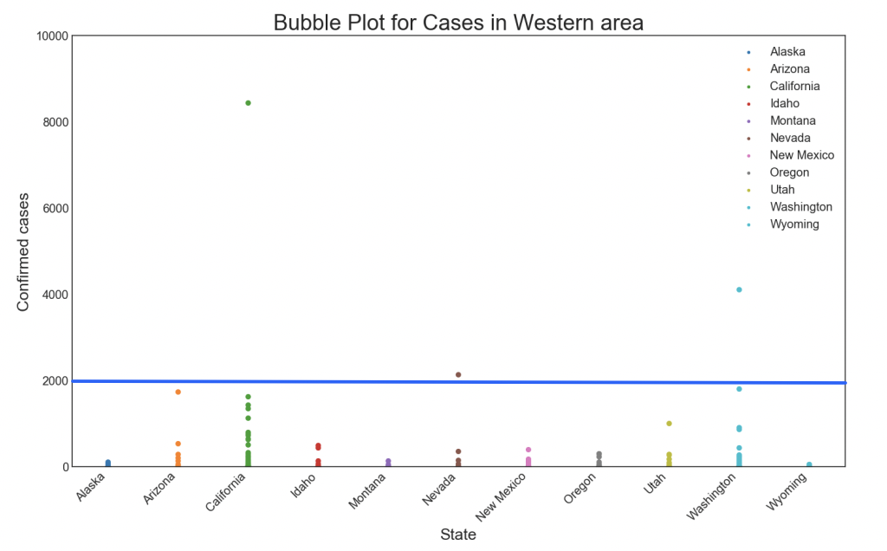
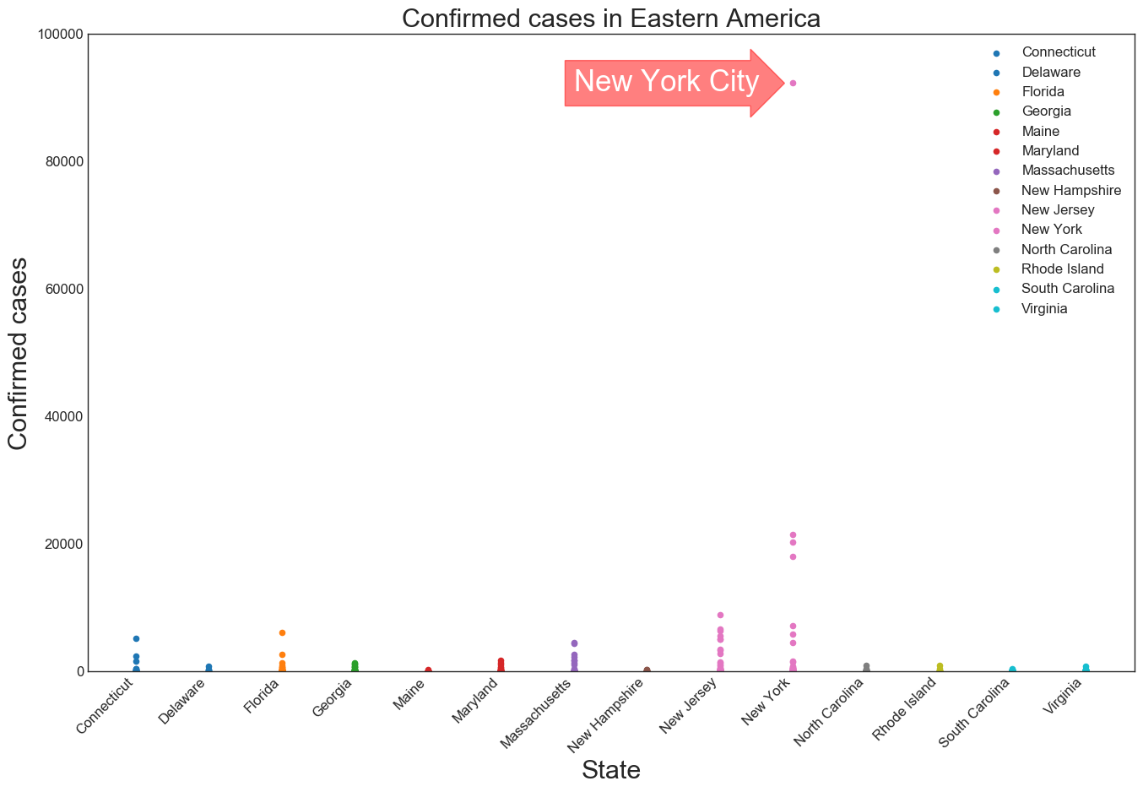
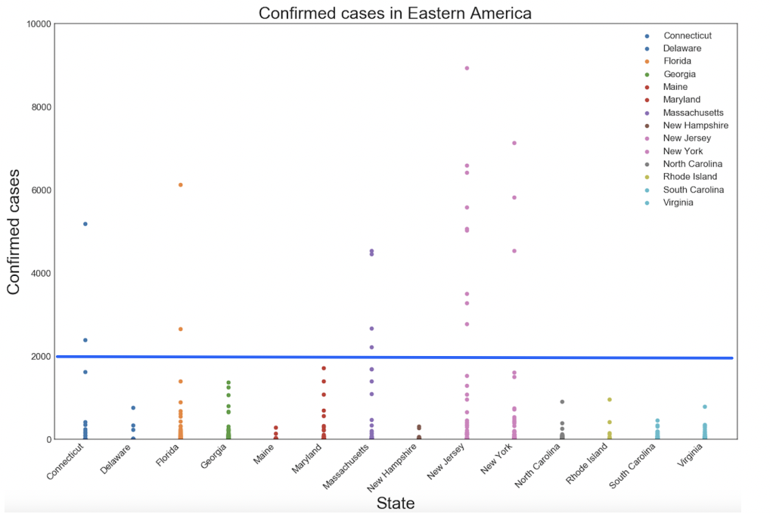
East Coast vs West Coast

Slide 19
04
PREDICTIVE ANALYSIS

Slide 20
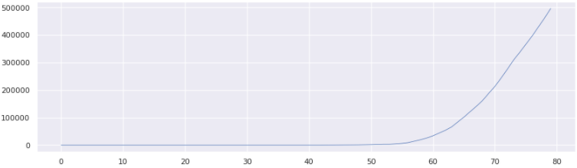
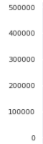
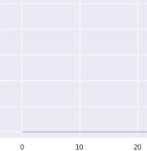
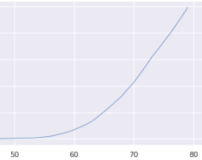
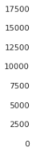
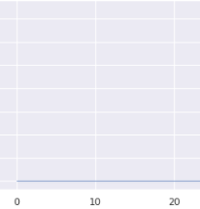
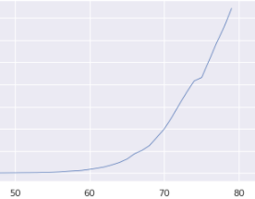
T.S Model
Data: 01/08/2020 - 04/10/2020
All
Confirmed
Death
Method
Aggregate daily cases by
Confirmed + Death
Confirmed
Death

Slide 21
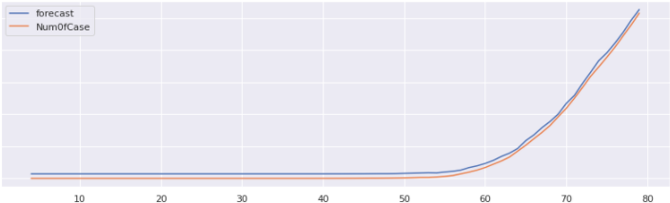
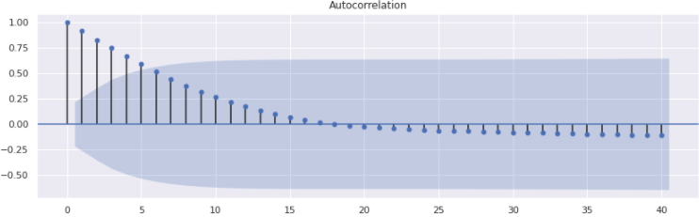
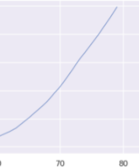
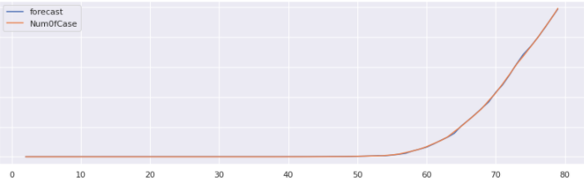
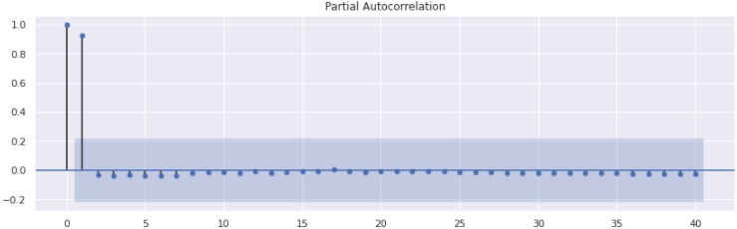
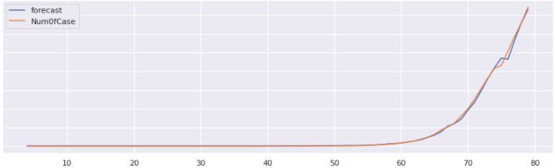
T.S Model
With the lag = 40

Slide 22


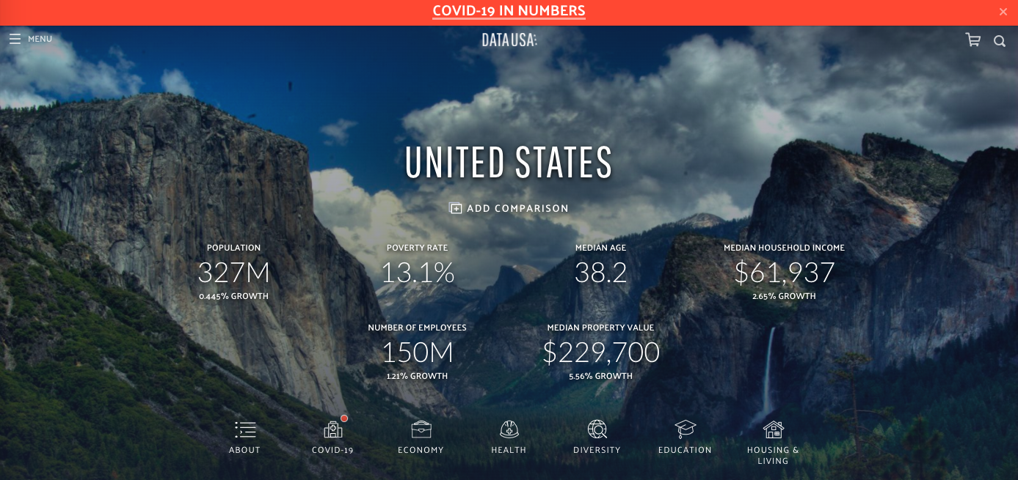

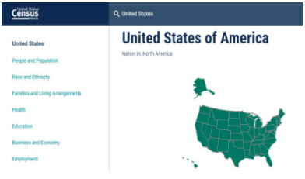
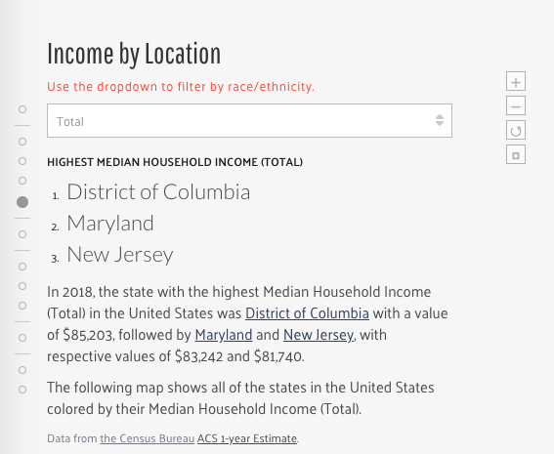

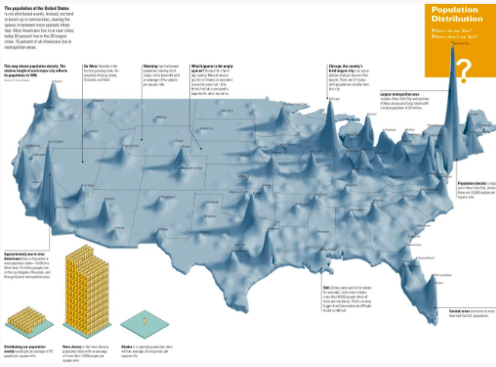
R.F Model
Economic
Methods
Besides the existing daily death and confirmed data,
I also collected the following info by state
Health
Education
Level
Population density

Slide 23
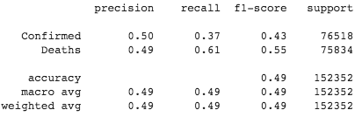
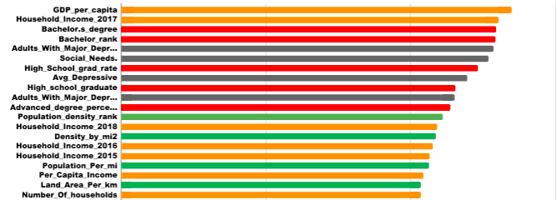
R.F Model
Model Evaluation
Significant Factors

Slide 24
05
Conclusion and Suggestion

Slide 25
Conclusion:
“Economic”, “Education Level”,”Health” issues are more important than population density.
The United States is in dangerous situation.
The East Coast is worse than the West Coast.
Although CO is below the average, we still have to be careful.
Government has done effective actions and people have concerned about the pandemic.
AWS cluster Advantages:
increases the productivity
fast innovation
increases the resource availability and strategics resource usage
Suggestion:
Streaming Data
Notes:
写bullet points吧
然后把详细描述放在下面
Both Confirmed and Death trend keeps increasing and “Economic”, “Education Level”,”Health” issues are more important than population density. We suggest government should take actions based on those low education level states or those states with high risks of potential mental illness.
AWS cluster increases the productivity and has fast innovation, also increases the resource availability and strategics resource usage, really good for team works.
suggestion：We can make streaming data, to generate covid-19 data and news data continuously

Slide 26

Questions?

